Slide 1
3D Bowling Ball Trajectory And Spin Analysis

Slide 2
The problem
Objectives
Detect and track bowling ball trajectory and estimate spin rate and rotation axis orientation
Challenges
High ball speed, lighting and reflections of bowling alleys
Usage
Bowling performance analysis.

Slide 3
The proposed solution
Detection
YOLO Neural Network for real-time ball detection
Three-dimensional reconstruction
Camera calibration and geometric calculations
Motion analysis
Optical flow with corner detection

Slide 4
State of the art
Bowling ball detection
From background subtraction with Hough circles to Deep Learning
YOLO for high speed and accuracy
Motion estimation
Optical flow with corner detection
Fast Flow Transformer (not used)

Slide 5
The processing pipeline

Slide 6
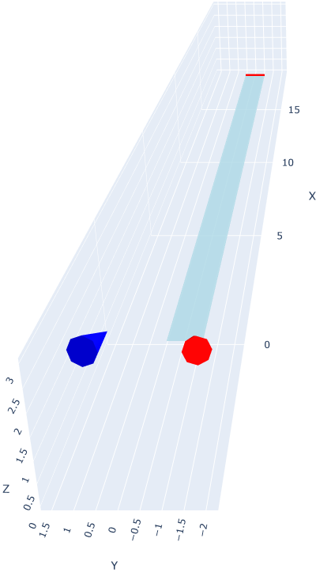
Calibration
Intrinsic calibration
Goal: Correct lens distortion and find camera calibration
Method: Corner detection on a 9×6 checkerboard and subsequent reprojection error minimization
Output: Calibration matrix K and distortion vector D
Extrinsic calibration
Goal: Estimate camera position and orientation
Method: Manual lane corners detection and Perspective-n-Points algorithm with IPPE solver to project these points in world coordinates
Output: Rotation matrix R, translation vector t, and projection matrix P = K [R|t]

Slide 7
Video preprocessing
Synchronization
Goal: Align two independent video streams for stereo analysis
Method: Cross-correlation of audio tracks to compute time offset and resampling
Outputs: Two frame-aligned videos with same sample rate
Undistorsion
Goal: Correct lens distortions for geometric accuracy
Method: Apply intrinsic calibration with pixel-wise correction and re-computation of K
Output: Geometrically correct video frames

Slide 8
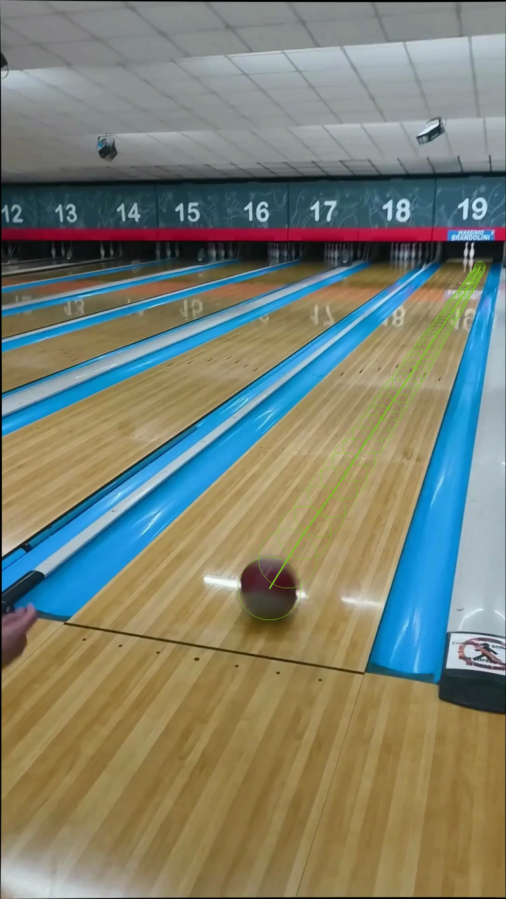
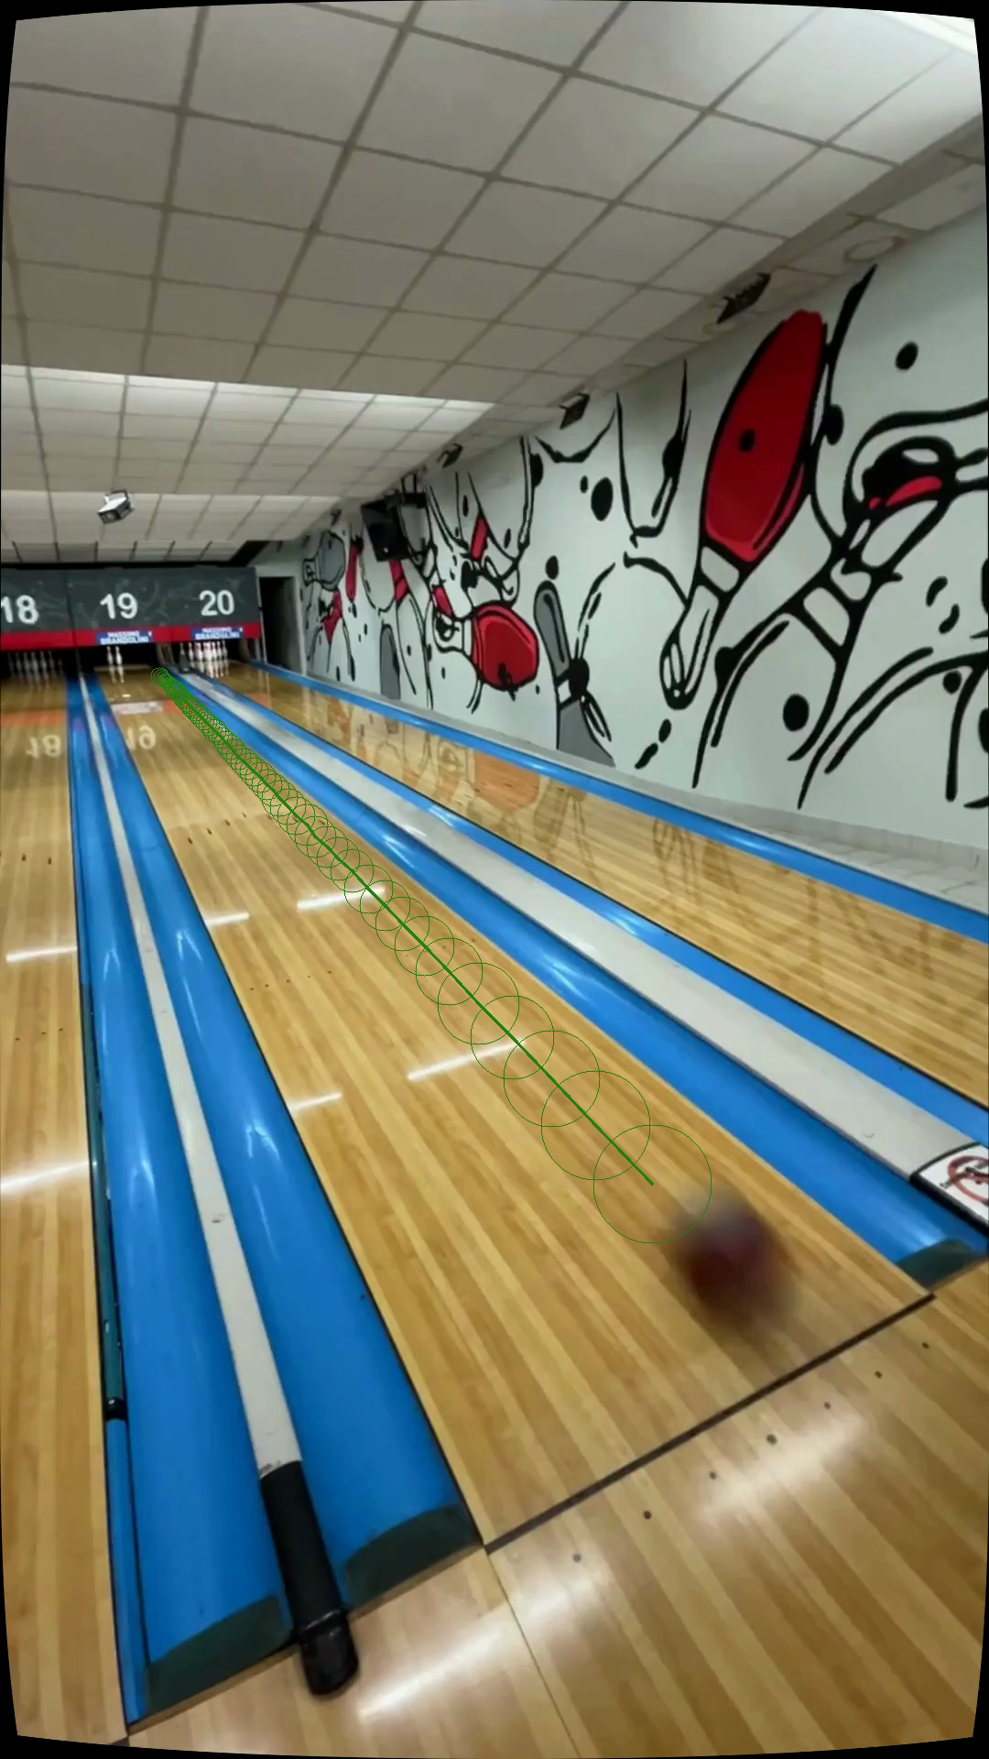
Tracking
Pretrained YOLO (sports ball class) which returns bounding box per frame with ball center and radius
Dynamic ROI cropping for faster and more accurate detection
Interpolation for missing radii or centers to have a smooth and complete trajectory
Output: Continuous 2D ball path with radius estimates per frame

Slide 9
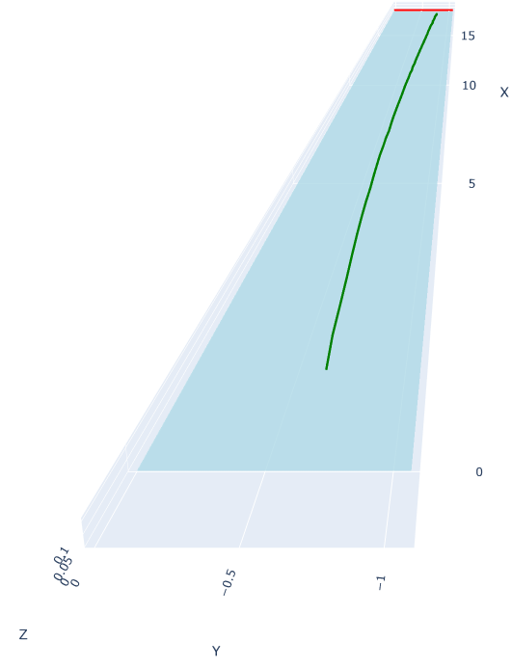
Localization
Triangulation of corresponding points from synchronized videos using the projection matrices P using Direct Linear Transform to find the 3D point
Output: Coherent 3D ball trajectory in world coordinates

Slide 10
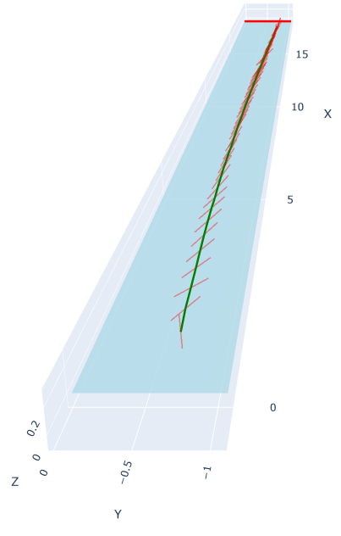
Rotation axis and speed
Feature detection using Shi-Tomasi corners inside ball ROI ad tracking with Lucas-Kanade optical flow
Project tracked points onto ball surface using predicted radius and compute the 3D displacement vectors
Compute the rotation axis with the cross product of 3D vectors (and average them)
Compute the angular displacement with the dot product between consecutive positions vectors and weight features by radial distance from center and compute the spin rate.
Output: Smoothed, per-frame spin rate and 3D rotation axis

Slide 11
Conclusions
Ball detection
Classical methods are limited by reflections and distance
YOLO object detection is more accurate, reliable frame-by-frame tracking
Motion estimation
Spin rate consistent across trajectory with a slight discrepancies between camera views due to perspective and lighting
3D rotation axis robust and physically accurate
Limitations and improvements
Tracking challenges as ball moves away from start of lane and goes in darker zones
Higher-resolution cameras, additional camera placements along the lane, Multi-view tracking for improved spin and trajectory accuracy

